Slide 1
Module 05: Game Theory
July 17th, 2026

Slide 2
Detailed Contents
Game Theory. Competitive games, rectangular game, saddle point, minimax (maximin) method of optimal strategies, value of the game. Solution of games with saddle points, dominance principle. Rectangular games without saddle point – mixed strategy for 2 X 2 games.
**05 Hrs.

Slide 3
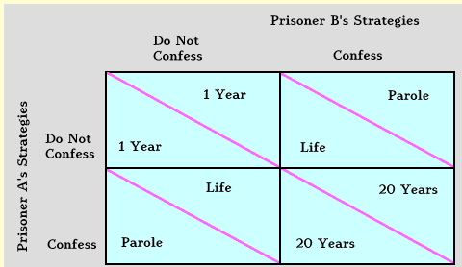
The Prisoner's Dilemma
The prisoner's dilemma is the story of two criminals who have been arrested for a heinous crime and are being interrogated separately. Each knows that if neither of them talks, the case against them is weak and they will be convicted and punished for lesser charges. If this happens, each will get one year in prison. If both confess, each will get 20 years in prison. If only one confesses and testifies against the other, the one who did not cooperate with the police will get a life sentence and the one who did cooperate will get parole. The table below illustrates the structure of payoffs.
Nash equilibrium: (in economics and game theory) a stable state of a system involving the interaction of different participants, in which no participant can gain by a unilateral change of strategy if the strategies of the others remain unchanged.
Ref: http://ingrimayne.com/econ/IndividualGroup/PrisDilm.html

Slide 4
Objective
After completing this module, students will be able to:
Understand the principles of zero-sum, two-person games.
Analyze pure strategy games and use dominance to reduce the size of a game.
Solve mixed strategy games when there is no saddle point.

Slide 5
Introduction
Game theory is one way to consider the impact of the strategies of others on our strategies and outcomes. A game is a contest involving two or more decision makers, each of whom wants to win. Game theory is the study of how optimal strategies are formulated in conflict.
The study of game theory dates back to 1944, when John von Neumann and Oscar Morgenstern published their classic book, Theory of Games and Economic Behavior. Since then, game theory has been used by army generals to plan war strategies, by union negotiators and managers in collective bargaining, and by businesses of all types to determine the best strategies given a competitive business environment.
Game theory continues to be important today. In 1994, John Harsanui, John Nash, and Reinhard Selten jointly received the Nobel Prize in Economics from the Royal Swedish Academy of Sciences. In their classic work, these individuals developed the notion of noncooperative game theory. After the work of John von Neumann, Nash developed the concepts of the Nash equilibrium and the Nash bargaining problem, which are the cornerstones of modern game theory.

Slide 6
Managerial Applications of the Theory of Games
The techniques of game theory can be effectively applied to various managerial problems as detailed below:
1) Analysis of the market strategies of a business organization in the long run.
2) Evaluation of the responses of the consumers to a new product.
3) Resolving the conflict between two groups in a business organization.
4) Decision making on the techniques to increase market share.
5) Material procurement process.
6) Decision making for transportation problem.
7) Evaluation of the distribution system.
8) Evaluation of the location of the facilities.
9) Examination of new business ventures and
10) Competitive economic environment.

Slide 7
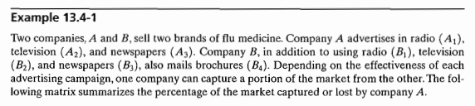
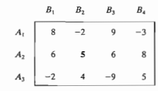
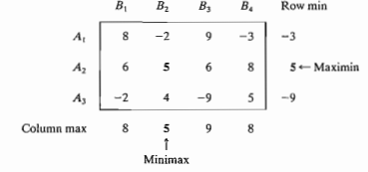

Slide 8
Key concepts in the Theory of Games
Players: The competitors or decision makers in a game are called the players of the game.
Strategies: The alternative courses of action available to a player are referred to as his strategies.
Pay off: The outcome of playing a game is called the pay off to the concerned player.
Optimal Strategy: A strategy by which a player can achieve the best pay off is called the optimal strategy for him.
Zero-sum game: A game in which the total payoffs to all the players at the end of the game is zero is referred to as a zero-sum game.

Slide 9
Payoff matrix: The tabular display of the payoffs to players under various alternatives is called the payoff matrix of the game.
Pure strategy: If the game is such that each player can identify one and only one strategy as the optimal strategy in each play of the game, then that strategy is referred to as the best strategy for that player and the game is referred to as a game of pure strategy or a pure game.
Mixed strategy: If there is no one specific strategy as the ‘best strategy’ for any player in a game, then the game is referred to as a game of mixed strategy or a mixed game. In such a game, each player has to choose different alternative courses of action from time to time.
N-person game: A game in which N-players take part is called an N-person game.

Slide 10
Maximin-Minimax Principle : The maximum of the minimum gains is called the maximin value of the game and the corresponding strategy is called the maximin strategy. Similarly the minimum of the maximum losses is called the minimax value of the game and the corresponding strategy is​ called the minimax strategy. ​
Saddle point: A saddle point of a game is that place in the payoff matrix where the maximum of the row minima is equal to the minimum of the column maxima. The payoff at the saddle point is called the value of the game and the corresponding strategies are called the pure strategies.
Dominance: One of the strategies of either player may be inferior to at least one of the remaining ones. The superior strategies are said to dominate the inferior ones.

Slide 11
Game models are classified by the number of players, the sum of all payoffs, and the number of strategies employed.
Due to the mathematical complexity of game theory, we limit the analysis in this module to games that are two person and zero sum.
A two-person game is one in which only two parties can play—as in the case of a union and a company in a bargaining session. For simplicity, X and Y represent the two game players.
Zero sum means that the sum of losses for one player must equal the sum of gains for the other player. Thus, if X wins 20 points or dollars, Y loses 20 points or dollars. With any zero-sum game, the sum of the gains for one player is always equal to the sum of the losses for the other player. When you sum the gains and losses for both players, the result is zero—hence the name zero-sum games.

Slide 12
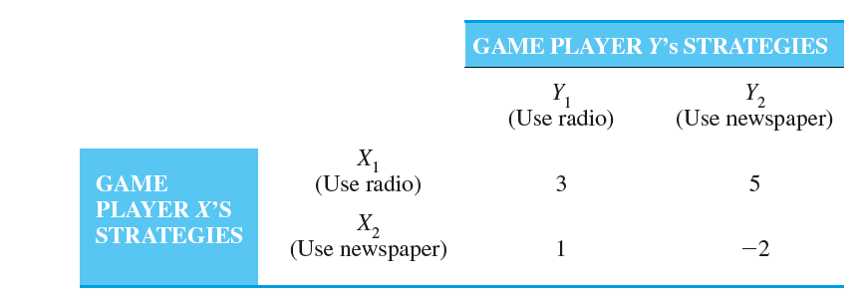
Table 1
A positive number in Table 1 means that X wins and Y loses. A negative number means that Y wins and X loses. It is obvious from the table that the game favors competitor X, since all values are positive except one. If the game had favored player Y, the values in the table would have been negative. In other words, the game in Table 1 is biased against Y. However, since Y must play the game, he or she will play to minimize total losses.
To do this, Player Y would use the minimax criterion, our next topic.

Slide 13
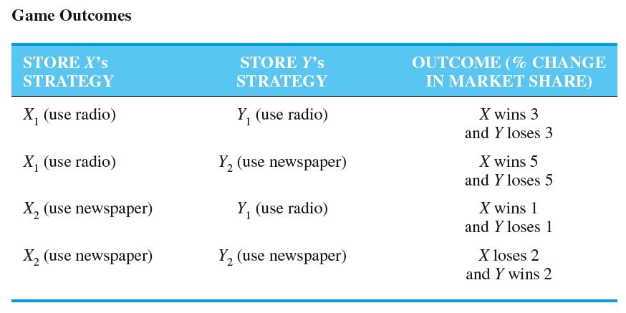

Slide 14
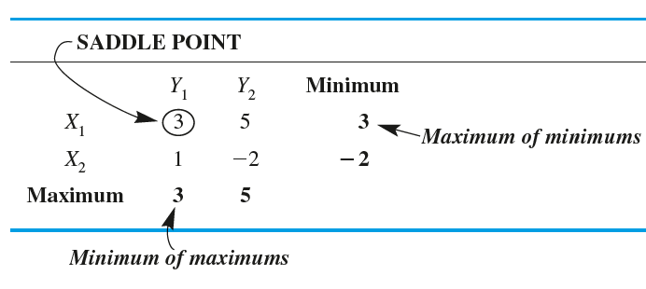
The Minimax Criterion
For two-person, zero-sum games, there is a logical approach to finding the solution: In a zero-sum game, each person should choose the strategy that minimizes the maximum loss, called the minimax criterion. This is identical to maximizing one’s minimum gains, so for one player, this could be called the maximin criterion.
Let us use the example in Table 1 to illustrate the minimax criterion. This is a two-person zero-sum game with the strategies for player Y given as the columns of the table. The values are gains for player X and losses for player Y. Player Y is looking at a maximum loss of 3 if strategy Y₁ is selected and a maximum loss of 5 if strategy Y₂ is selected. Thus, Player Y should select strategy Y₁, which results in a maximum loss of 3 (the minimum of the maximum possible losses). This is called the upper value of the game. Table 2 illustrates this minimax approach.
Table 1
Table 2

Slide 15
In considering the maximin strategy for player X (whose strategies correspond to the rows of the table), let us look at the minimum payoff for each row. The payoffs are +3 for strategy and for strategy X₁ and -2 for strategy X₂. The maximum of these minimums is +3, which means strategy X₁, will be selected. This value (+3) is called the lower value of the game.
If the upper and lower values of a game are the same, this number is called the value of the game, and an equilibrium or saddle point condition exists. For the game presented in Table 2, the value of the game is 3 because this is the value for both the upper and lower values. The value of the game is the average or expected game outcome if the game is played an infinite number of times.
In implementing the minimax strategy, player Y will find the maximum value in each column and select the minimum of these maximums. In implementing the maximin strategy, player X will find the minimum value in each row and select the maximum of these minimums. When a saddle point is present, this approach will result in pure strategies for each player. Otherwise, the solution to the game will involve mixed strategies. These concepts are discussed in the following sections.

Slide 16
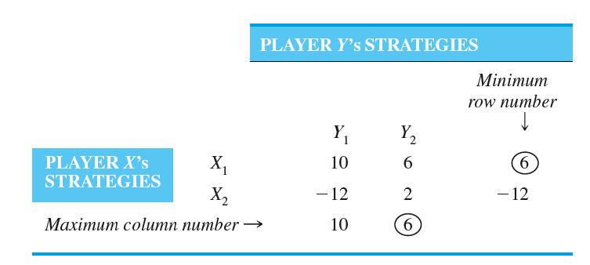
Pure Strategy Games
When a saddle point is present, the strategy each player should follow will always be the same regardless of the other player’s strategy. This is called a pure strategy.
A saddle point is a situation in which both players are facing pure strategies.

Slide 17
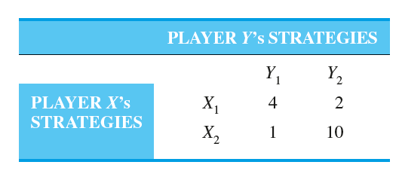
Mixed Strategy Games
When there is no saddle point, players will play each strategy for a certain percentage of the time. This is called a mixed strategy game. The most common way to solve a mixed strategy game is to use the expected gain or loss approach. The goal of this approach is for a player to play each strategy a particular percentage of the time so that the expected value of the game does not depend upon what the opponent does. This will only occur if the expected value of each strategy is the same.

Slide 18
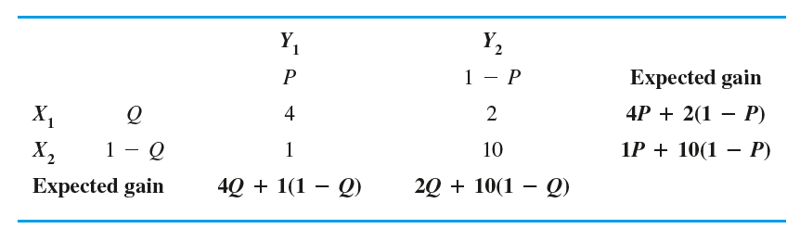
Game Table for Mixed Strategy Game with Percentages (P, Q) Shown

Slide 19
Therefore, to solve this, we set these two expected values equal, as follows:
4P + 2(1 - P) = 1P + 10(1 - P)
Solving this for P, we have
P = 8/11
and
1 - P = 1 - 8/11 = 3/11
Thus, 8/11 and 3/11 indicate how often player Y will choose strategies Y₁and Y₂ respectively. The expected value computed with these percentages is
1P + 10(1 - P) = 1(8/11) + 10(3/11) = 38/11 = 3.46

Slide 20
Performing a similar analysis for player X, we let Q be the percentage of the time that strategy is played and be the percentage of the time that strategy is played. Using these, we compute the expected gain shown in Table. We set these equal, as follows:
4Q + 1(1 - Q) = 2Q + 10(1 - Q)
Solving for Q, we get
Q = 9/11
and
1 - Q = 2/11
Thus, 9/11 and 2/11 indicate how often player X will choose strategies X1 and X2 respectively. The expected gains with these probabilities will also be 38/11, or 3.46.

Slide 21
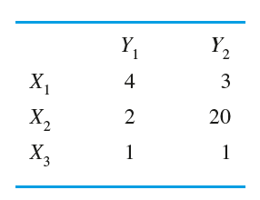
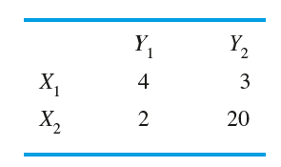
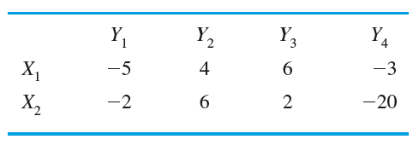
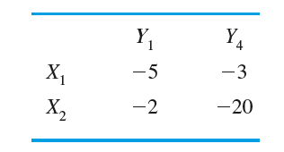
Dominance
The principle of dominance can be used to reduce the size of games by eliminating strategies that would never be played. A strategy for a player is said to be dominated if the player can always do as well or better playing another strategy. Any dominated strategy can be eliminated from the game. In other words, a strategy can be eliminated if all its game’s outcomes are the same or worse than the corresponding game outcomes of another strategy.
Using the principle of dominance, we reduce the size of the following game:
In this game, X₃ will never be played because X can always do better by playing X₁ or X₂. The new game is
Here is another example:
In this game, Y would never play Y₂ and Y₃ because Y could always do better playing Y₁ or Y₄
The new game is

Slide 22
Summary
Game theory is the study of how optimal strategies are formulated in conflict. Because of the mathematical complexities of game theory, this module is limited to two-person and zero-sum games.
A two-person game allows only two people or two groups to be involved in the game. Zero sum means that the sum of the losses for one player must equal the sum of the gains for the other player. The overall sum of the losses and gains for both players, in other words, must be zero.
Depending on the actual payoffs in the game and the size of the game, a number of solution techniques can be used.
In a pure strategy game, strategies for the players can be obtained without making any calculations.
When there is not a pure strategy, also called a saddle point, for both players, it is necessary to use other techniques, such as the mixed strategy approach, dominance, and a computer solution for games larger than 2 X 2.

Slide 23
Glossary
Dominance A procedure that is used to reduce the size of the game.
Minimax Criterion A criterion that minimizes one’s maximum losses. This is another way of solving a pure strategy game.
Mixed Strategy Game A game in which the optimal strategy for both players involves playing more than one strategy over time. Each strategy is played a given percentage of the time.
Pure Strategy A game in which both players will always play just one strategy.
Saddle Point Game A game that has a pure strategy.
Two-Person Game A game that has only two players.
Value of the Game The expected winnings of the game if the game is played a large number of times.
Zero-Sum Game A game in which the losses for one player equal the gains for the other player.

Slide 24
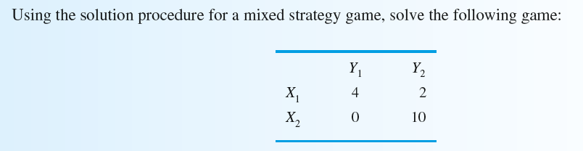
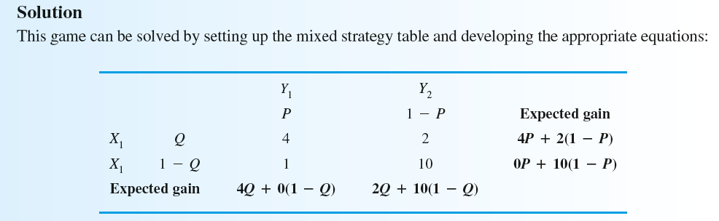
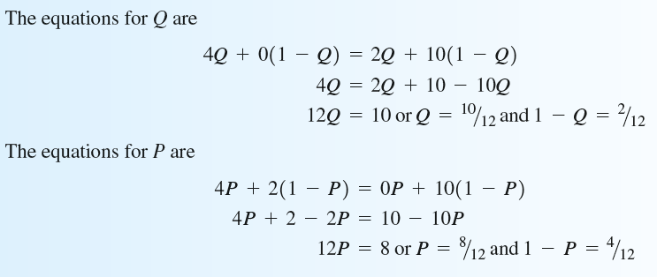

Slide 25
By Using Oddments

Slide 26
Practice work
Multiple Choice
https://forms.gle/RyXCA682kmZ2KxqNA
True or False
https://forms.gle/DQgXpr2tjddgtbJF7
Problems
Reference:
https://wps.pearsoned.co.uk/wps/media/objects/12987/13299709/rsh_qam11_module04.pdf
Game theory #1||Pure & Mixed Strategy||in Operations research||Solved problem||By:- Kauserwise https://www.youtube.com/watch?v=fSuqTgnCVRg
Lecture Series on Fundamentals of Operations Research by Prof. G. Srinivasan, Department of Management Studies, IIT Madras. For more details on NPTEL visit http://nptel.ac.in
https://www.youtube.com/watch?v=a2QgdDk4Xjw&list=PLjc8ejfjpgTf0LaDEHgLB3gCHZYcNtsoX

